Slide 1
Web Development & Design Foundations with HTML5
7th Edition
Chapter 4
Key Concepts
Copyright © Terry Felke-Morris

Slide 2
Learning Outcomes
In this chapter, you will learn how to ...
  Create inline styles
  Embedded Style Sheets
  Linking External Style Sheets
  Conflicting Styles
  Positioning Elements

Slide 3
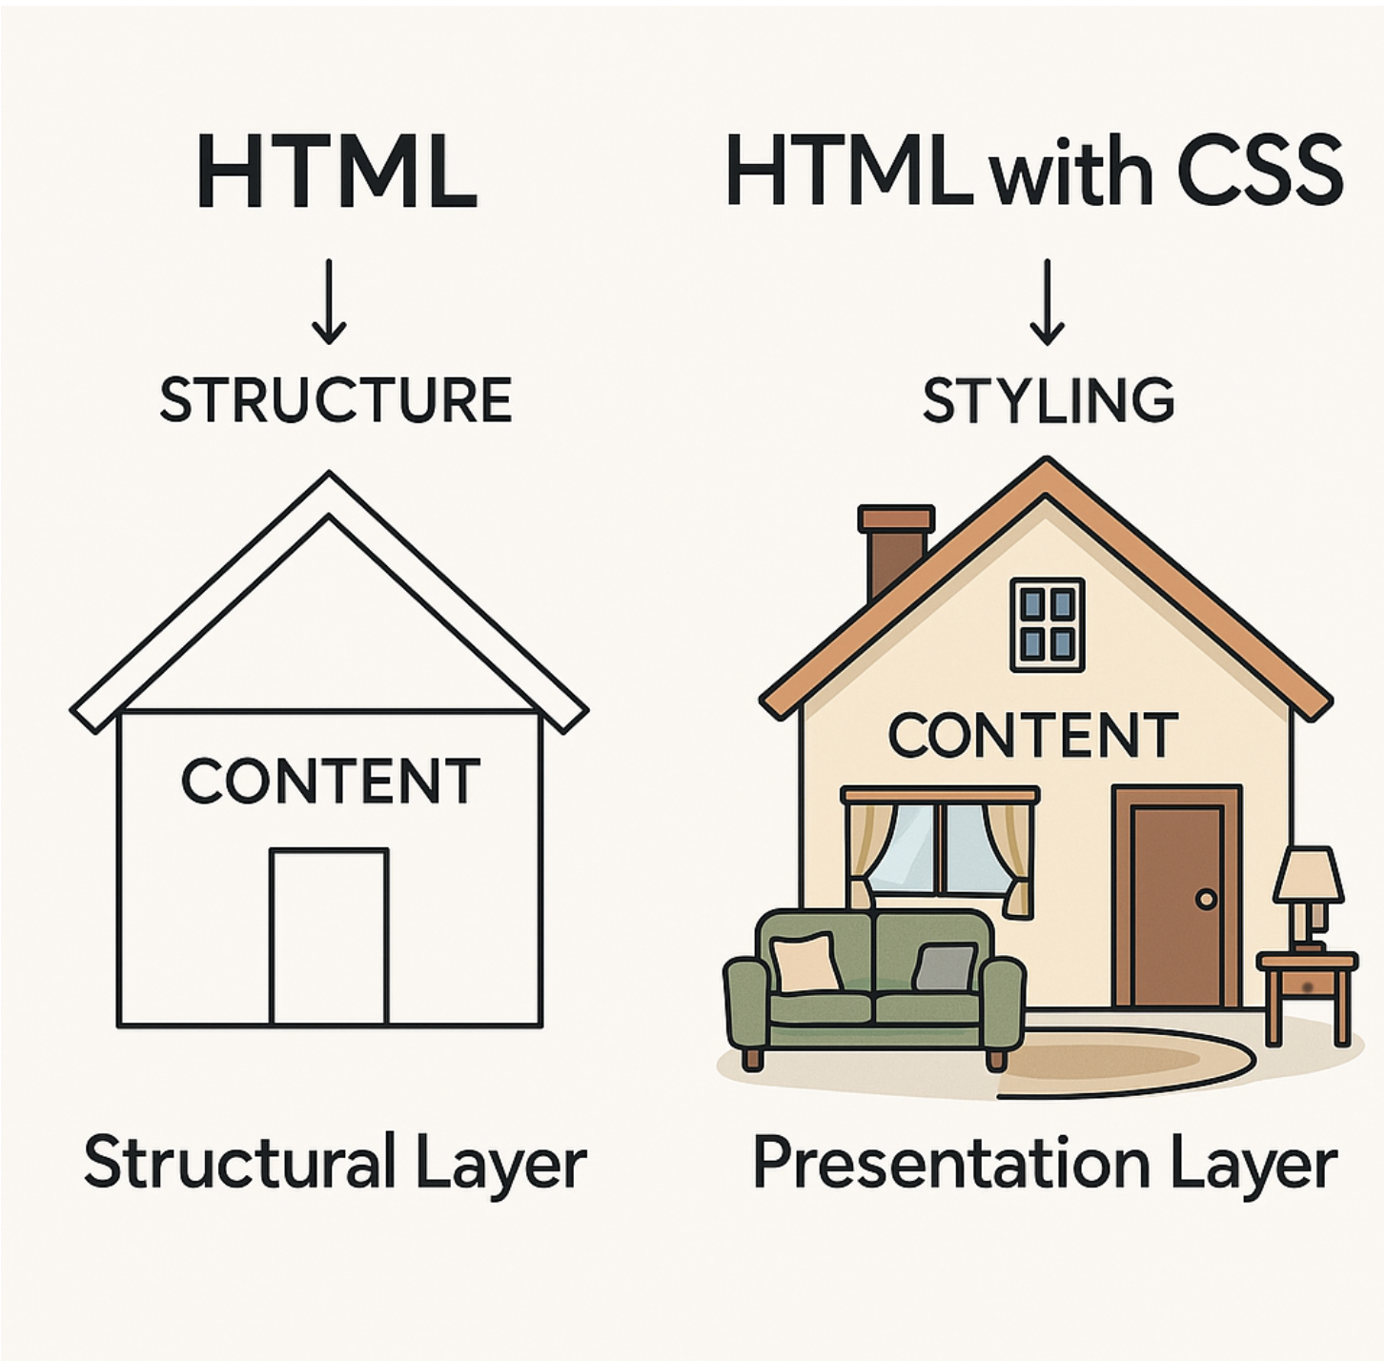
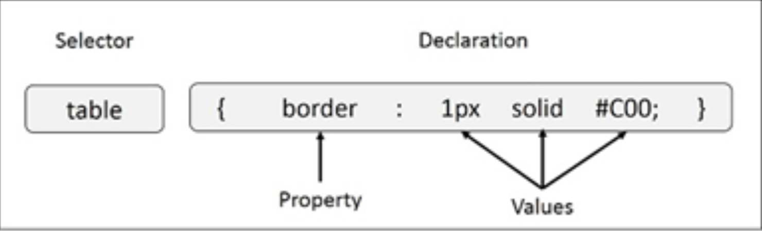
CASCADING STYLE SHEET (CSS)
A CSS comprises of style rules that are interpreted by the browser and then applied to the corresponding elements in your document.
Formatting Instructions of CSS

Slide 4
INLINE STYLES
CSS can be added to HTML documents in 3 ways:
  Inline CSS
  Internal CSS
  External CSS
Using style attributes inside HTML Elements
For Example:
<body>
<h1 style = “ color: blue; font-size: 24px;”> Welcome to Inline CSS! </h1>
</body>

Slide 5
EMBEDDED style sheets
CSS can be added to HTML documents in 3 ways:
  Inline CSS
  Internal CSS
  External CSS
Using <style> elements in the <head> section
For Example:
<head>
<style>
h1 { color : blue; font-size : 24px; }
</style>
</head>
<body>
<h1> Welcome to Inline CSS! </h1>
</body>

Slide 6
LINKING EXTERNAL STYLE SHEETS
CSS can be added to HTML documents in 3 ways:
  Inline CSS
  Internal CSS
  External CSS
Using <link> element to link to an external CSS file
For Example:
Index.html
style.css
<head>
<link rel =“stylesheet” type =“text/css” href=“style.css”>
</head>
<body>
<h1> Welcome to Inline CSS! </h1>
</body>
h1 { color : blue; font-size : 24px; }

Slide 7
CONFLICTING STYLES
In CSS, a conflicting style happens when two or more style rules target the same element but set different values for the same property.
For Example:
Index.html
style.css
<head>
<link rel =“stylesheet” type =“text/css” href=“style.css”>
</head>
<body>
  <p class="intro" id="first">Hello world!</p>
</body>
p { color: blue; }
.intro { color: green; }
#first { color: red; }
All three rules apply to the same <p> element, and all set a color — so they conflict.

Slide 8
CONFLICTING STYLES
For Example:
Index.html
style.css
<head>
<link rel =“stylesheet” type =“text/css” href=“style.css”>
</head>
<body>
  <p style =“ color: yellow;” class="intro" id="first">Hello world!</p>
</body>
p { color: blue; }
.intro { color: green; }
#first { color: red; }
How the browser resolves it?
“Cascading” means the order of priority.
Based on W3C, there are 3 step hierarchy.
          Importance
          Specificity
          Source Order

Slide 9
CONFLICTING STYLES
For Example:
Follow Importance:
Highest priority = inline style
2nd priority = internal style
External styles
Default styles
Index.html
style.css
<head>
<link rel =“stylesheet” type =“text/css” href=“style.css”>
</head>
<body>
  <p style =“ color: yellow;” class="intro" id="first">Hello world!</p>
</body>
p { color: blue; }
.intro { color: green; }
#first { color: red; }
In this case, <p> will turn yellow

Slide 10
CONFLICTING STYLES
For Example:
Follow Specificity:
Highest priority = id selector
2nd priority = class selector
Element selector
Index.html
style.css
<head>
<link rel =“stylesheet” type =“text/css” href=“style.css”>
</head>
<body>
  <p class="intro" id="first">Hello world!</p>
</body>
p { color: blue; }
.intro { color: green; }
#first { color: red; }
In this case, <p> will turn red

Slide 11
CONFLICTING STYLES
For Example:
Follow Source Order:
If two rules have the same importance and specificity, the one that appears last in the code wins.
Index.html
style.css
<head>
<link rel =“stylesheet” type =“text/css” href=“style.css”>
</head>
<body>
  <p class="intro" id="first">Hello world!</p>
</body>
p { color: blue; }
p { color: green; }
In this case, <p> will turn green

Slide 12

POSITIONING ELEMENTS
Positioning controls how elements are placed on a web page , whether they follow the normal document flow or are manually positioned.
Type | Behaviour | Description
static | Default | Elements appear in the normal flow of the page (top to bottom). You can’t use top, left, right, or bottom.
relative | Moves relative to its original position | The element still takes up its original space but can be shifted around.
absolute | Moves relative to its nearest positioned parent | The element is taken out of the normal flow and placed exactly where you set it.

Slide 13
POSITIONING ELEMENTS
Type | Behaviour | Description
fixed | Stays fixed to the viewport | The element stays in place even when the page is scrolled (like a sticky navbar).
sticky | Mix of relative + fixed | It behaves normally until a certain scroll point, then it sticks in place.
Try out by yourself via W3Schools Tutorial. Click Tutorial

